Slide 1
Title: An Efficient Machine Learning Approach to Detect Sentiments from Text Data.
CSE-713 Group-Presentation
Group Members:
NAZMUL KARIM TANVIR (23166011)
TOUFIQUL ALAM SAMS (24166027)
TASNIM FUYARA CHHOAN (23366035)
SAMIN YASAR (23273007)

Slide 2
Table of Contents
01
03
05
Motivation & Objectives
Data Set
References
02
04
Reviewed Papers
Work Plan

Slide 3
Motivation:
Understanding Human Emotions
Enhancing NLP systems
Improve Decision Making Abilities
Mental Health Analysis
Research Objective:
Comprehend sentiment analysis
Increase level of mid polarities of the datasets
Bias issues

Slide 4
Sample Reviewed Papers
Paper 1
Title: News text Analysis using Text Summarization and Sentiment Analysis based on NLP
The paper introduces a text summarization model using natural language processing (NLP) and sentiment analysis to address information overload. It uses the NLTK library and Python for sentiment analysis, achieving 91.67% accuracy. However, its reliance on a self-generated dataset and specific tools may limit its generalizability and flexibility. Future work aims to enhance the model with advanced tools, NLP techniques, and a recommendation system for broader applicability across different domains and languages.
Paper 2
Title: Sentiment Analysis of Covid-19 Tweets using Twitter Database–A Global Scenario
The study "Sentiment Analysis of Covid-19 Tweets using Twitter Database–A Global Scenario" offers a comprehensive exploration of global sentiments during the pandemic. By analyzing Twitter data from various regions, the research highlights the prevalence of sadness and fear, particularly in developing countries like India. However, limitations such as platform dependency and sarcasm detection challenges underscore the need for nuanced interpretation of findings.

Slide 5
Sample Reviewed Papers
Paper 3
Title: Sentiment Analysis of Weather-Related Tweets from Cities within Hot Climates
Through an analysis of weather-related tweets from Phoenix and Singapore, this study identified a pattern of higher pain during temperature rises. Singapore was always negative, although Phoenix's feelings changed with the seasons. These results show how regional opinions are reflected on social media: tweets from Phoenix mimic weather forecasts, and Singaporeans express dissatisfaction. Additionally, the data points to long-term heat repercussions and vulnerability to local climate events.
Paper 4
Title: Sentiment Analysis on Tourism Place using Naive Bayes
The paper introduces a robust framework for news text analysis through NLP-based summarization and sentiment analysis. It addresses information overload by efficiently extracting insights from large textual datasets. Despite limitations, its accuracy and utility render it valuable across industries. Further research is needed to enhance its capabilities across domains and languages.

Slide 6
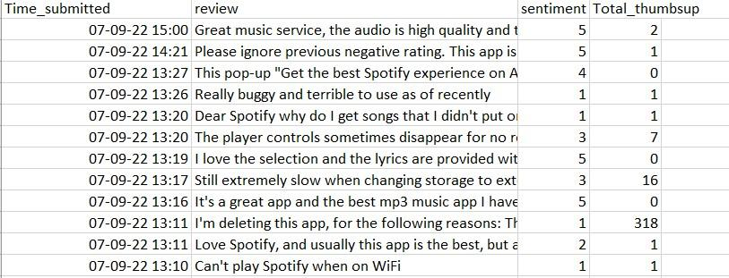
Data analysis
Dataset - 10,000 Spotify review

Slide 7
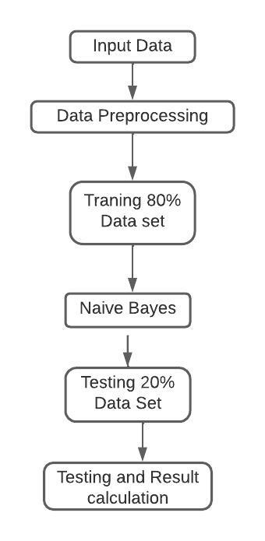
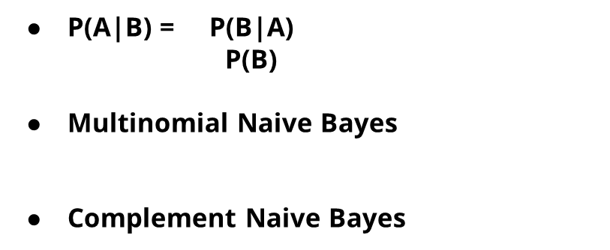
Workflow
Naive Bayes Model
RNN

Slide 8
References
Mishra, A., Sahay, A., Pandey, M. A., & Routaray, S. S. (2023). News text analysis using text summarization and sentiment analysis based on NLP. In 2023 3rd International Conference on Smart Data Intelligence (ICSMDI) (pp. 28-31). Trichy, India. https://doi.org/10.1109/ICSMDI57622.2023.00014
Tejaswini, Z. , Rajeswari, K. (2022). Sentiment Analysis of Covid-19 Tweets using Twitter Database–A Global Scenario. https://ieeexplore.ieee.org/document/9989000
Dzyuban, Y., Ching, G., Yik, S., Tan, A., Crank, P., Banerjee, S., Pek, R. and Chow, W. (2022). Sentiment Analysis of Weather-Related Tweets from Cities within Hot Climates. Weather, Climate, and Society 14(4) pp. 1133-1145. Available at: https://journals.ametsoc.org/view/journals/wcas/14/4/WCAS-D-21-0159.1.xml . [Accessed 19 Apr 2024].
A. R. Atmadja, A. Rahmawati, C. N. Alam, P. Dauni and Y. Saputra. (2023) . Sentiment Analysis on Tourism Place using Naive Bayes . https://ieeexplore.ieee.org/document/10366891

Slide 9
Thank you Any Question ?

